Slide 1
Time Series Data
Handling Methods, Data Module, and Rolling Windows
By: Abdullah Othman

Slide 2
Objective and Learning Goals
Understanding time series data.
How to handle missing values.
How to deal with outliers.
How to build a module.

Slide 3
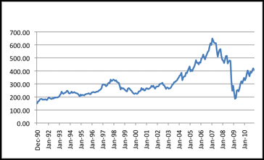
What is Time Series Data?
Data collected over time at regular intervals.
Each observation is time-stamped (daily, monthly, yearly, etc.).
Captures trends, seasonality, and patterns over time.
Examples:
  Stock prices by day.
  Temperature by hour.
  Website traffic by week

Slide 4
Characteristics of Time Series
Trend: A forward or downward shift in the level of the series over time.
Outliers: Shifts in data upward or downward that cannot be explained.
Seasonal Cycles: Repetitive events that occur at fixed intervals.
Non-seasonal: Repetitive events that occur, but their timing or magnitude varies.
Pulses and Steps:
  Pulses: A sudden change in values that happens once, creating a sharp rise or drop, then returning to normal.
  Steps: A sudden change in values that happens once, but it permanently changes the level of values afterwards.

Slide 5
Challenges
Choosing the right method for missing values.
Balancing outlier detection (sensitivity vs false alarms).
Selecting rolling window size & function.
Designing a reusable time series module.

Slide 6
Preprocessing Steps
Removing the missing values.
Removing outliers.
Applying rolling windows.

Slide 7
Handling NaNs Methods

Slide 8
Handling NaNs Methods
There are a lot of methods to handle missing values, but these are the ones I used :
  Fill Forward.
  Fill Backward.
  Window Mean.
  Linear Interpolation.

Slide 9
Handling NaNs Methods – Fill Forward
How it works: Replaces missing value with the last known value
Pros:
  Very simple and fast.
  Keeps data continuous (no gaps).
  Good when values don’t change much over time.
Cons:
  Can repeat wrong/old values.
  Not good for fast-changing data.
  May create bias if many missing points.
Use when the last value is still relevant (e.g., stock prices, sensor readings with small gaps).
→ Good for stable/slow-changing data.

Slide 10
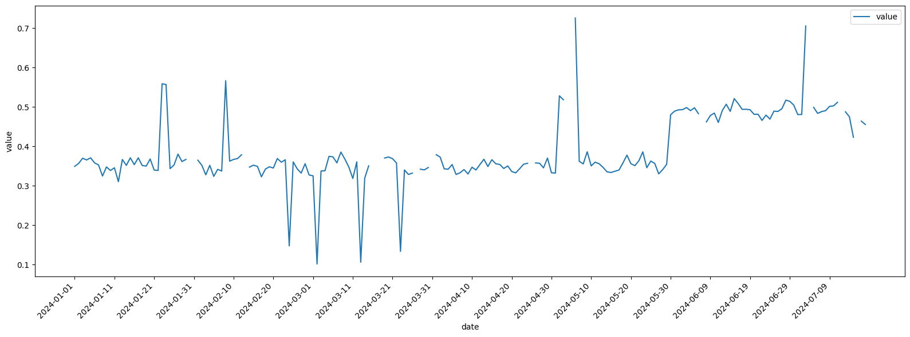
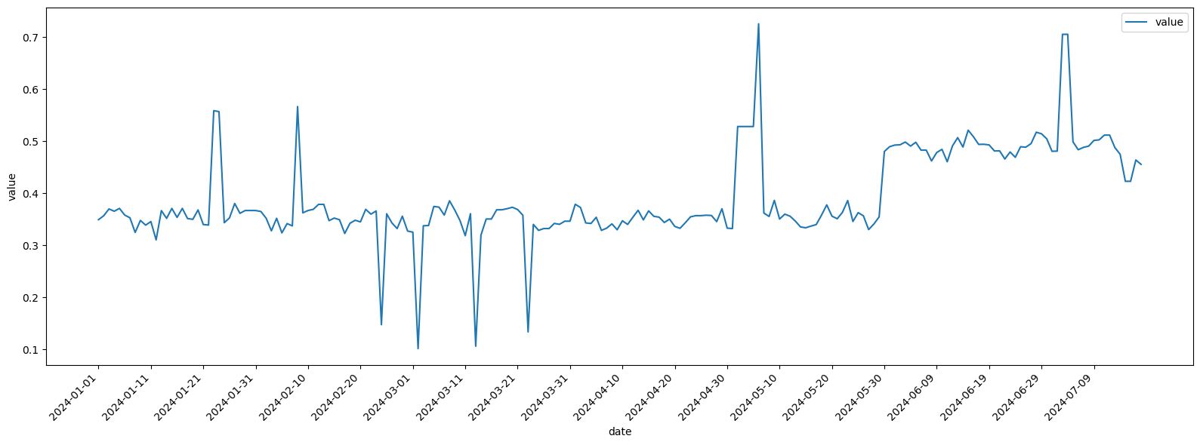
Handling NaNs Methods – Fill Forward
Missing values are replaced with the last known value.
Keeps the line smooth with no breaks (black arrow).
But can carry old values forward and make spikes look longer than they are (orange arrow).
Works best when data changes slowly, not with sudden shifts.
These 2 plots show a dataset before and after filling the missing values with
Fill Forward method.

Slide 11
Handling NaNs Methods – Fill Backward
How it works: Replaces missing value with the next known value
Pros:
  Very simple and fast.
  Keeps data continuous (no gaps).
  Useful when future values are more reliable.
Cons:
  Can copy future info backward (not realistic for real-time).
  Not good if data changes quickly.
  May distort trends before jumps or drops.
Use when the next value is more reliable (e.g., categorical labels, status fields).
→ Better for offline analysis, not for real-time streaming.

Slide 12

Handling NaNs Methods – Fill Backward
Missing values are filled with the next available value (black arrow).
Keeps data smooth and
gap-free.
But can pull future spikes backward (orange arrow), creating misleading patterns.
Works fine when values don’t change much, not ideal for sudden jumps.
These 2 plots show a dataset before and after filling the missing values with
Fill Backward method.

Slide 13
Handling NaNs Methods – Window Mean
How it works: Replaces a missing value with the average of nearby values in a chosen window.
Pros:
  Smooths data, reduces noise.
  Uses nearby context, not just one value.
  Better than forward/backward fill for fluctuating data.
Cons:
  Window size choice is tricky (too small = noisy, too big = too smooth).
  Can blur sudden changes/spikes.
  Not good for very small datasets.
Use when you want to smooth fluctuations and replace gaps with local averages.
→ Works well for noisy data with short gaps (sensors, financial data).

Slide 14
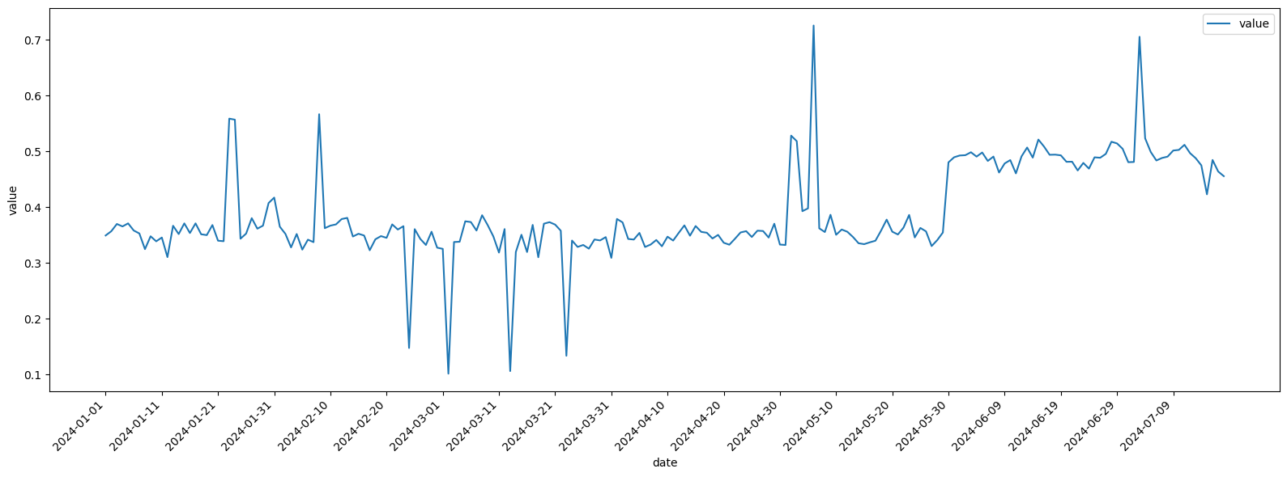
Handling NaNs Methods – Window Mean
Missing values are replaced with the average of nearby points (black arrow).
Smooths the series, reducing sharp gaps.
But can shrink peaks or dips (orange arrow), making sudden changes less visible.
Works best for data with gradual trends, not when fast shifts are important.
These 2 plots show a dataset before and after filling the missing values with
Window Mean method, with window size of 9.

Slide 15
Handling NaNs Methods – Linear Interpolation
How it works: Fills missing values by drawing a straight line between the values before and after the gap.
Pros:
  Simple and easy.
  Keeps trend between points.
  Works well for gradual changes.
Cons:
  Not good for sudden jumps/spikes.
  Can create unrealistic values if gaps are large.
  Assumes a straight-line change, which may not be true.
Use when data is expected to change gradually between points.
→ Best for small gaps in continuous data (temperature, gradual trends).

Slide 16

Handling NaNs Methods – Linear Interpolation
Missing values are filled by connecting points with a straight line.
Keeps spikes (black arrow) but can smooth sharp gaps unnaturally.
Small fluctuations (orange arrow) are filled smoothly, keeping the trend continuous.
Works best for gradual changes, not sudden jumps.
These 2 plots show a dataset before and after filling the missing values with
Linear Interpolation method.

Slide 17
Handling NaNs Methods - All
Fill Forward: Simple, keeps continuity, but can stretch old values too far.
Fill Backward: fills quickly but may pull future info backward.
Window Mean: Smooths series, but flattens spikes and reduces detail.
Linear Interpolation: Keeps trends, but creates artificial linear changes.

Slide 18
Handling NaNs Methods - Conclusion
No single method works best for all cases.
Fill Forward / Backward: Simple, fast, but can mislead during sudden changes.
Window Mean: Smooths data, good for trends, but flattens spikes.
Linear Interpolation: Keeps continuity, but assumes straight transitions.
Method choice depends on data behavior and goal (preserve detail vs smooth patterns).
Handling missing values is about trade-offs
choose the method that best fits your data’s nature and analysis needs.

Slide 19
Handling Outliers Methods

Slide 20
Handling Outliers Methods
There are a lot of methods to handle outliers, but these are the ones I used :
  Z-Score.
  Interquartile Range (IQR).
  Linear Regression.
  Local Outlier Factor (LOF).

Slide 21
Handling Outliers Methods – Z-Score
Pros:
  Simple & easy to use.
  Scale-independent (standardized).
  Clear cutoff for outliers.
Cons:
  Assumes data is normally distributed.
  Sensitive to mean & standard deviation shifts.
  May miss unusual patterns over time.
Use when data is normally distributed and fairly stable.
→ Good for large datasets, quick detection with a clear threshold.

Slide 22
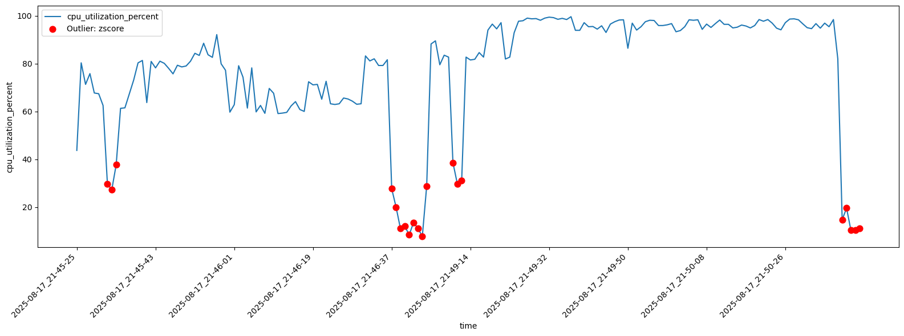
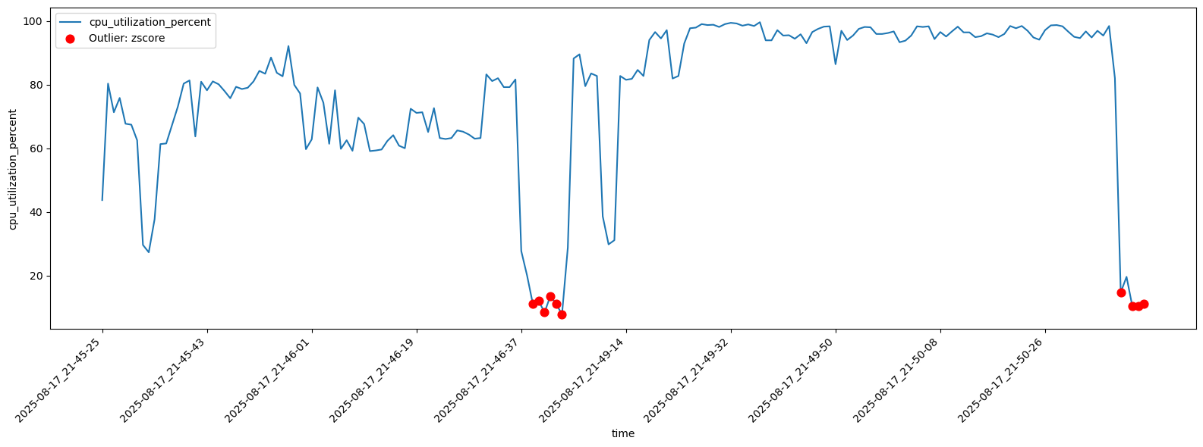
Handling Outliers Methods – Z-Score
Threshold 1.5: Finds more outliers, even small changes
Threshold 2.5: Finds only big unusual points
Trade-off:
  Lower number → more sensitive,
  Higher number → less sensitive
Takeaway: Pick threshold based on if you want more catches or fewer false alarms
These 2 plots shows z-score detection for outliers, the first plot for a threshold of 1.5 and the second one is for a threshold of 2.5.

Slide 23
Handling Outliers Methods – IQR
Pros:
  Easy to understand.
  Not affected much by extreme values.
  Works well for skewed data.
Cons:
  Misses outliers outside middle range.
  Not good for small datasets.
  Doesn’t use all data points.
Use when data is skewed or has extreme values.
→ Works well for small/medium datasets, robust to a few big spikes.

Slide 24
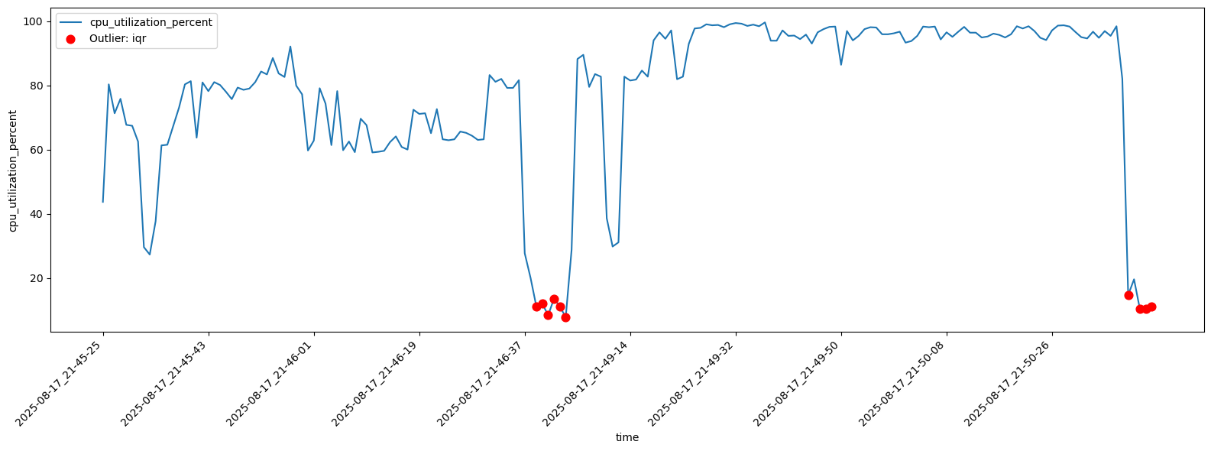
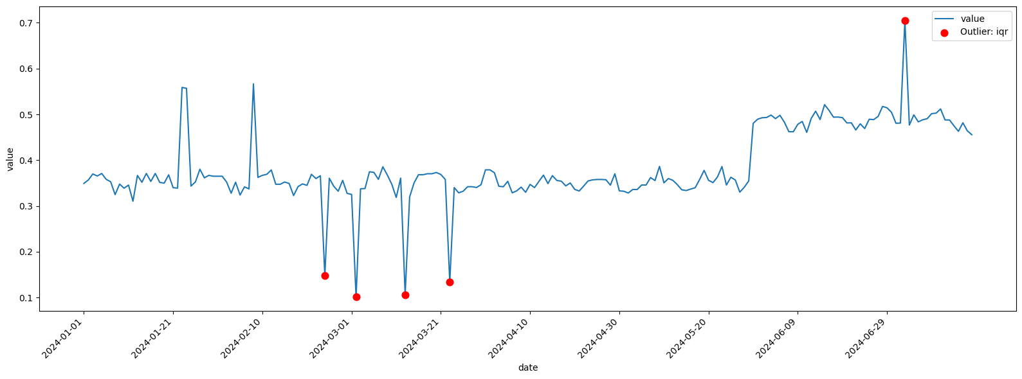
Handling Outliers Methods – IQR
First plot: IQR flags big drops and spikes, but misses smaller odd points.
Second plot: Catches highs and lows, but not all unusual changes.
Small dataset: Makes IQR less reliable for spotting all outliers.
Overall: Good for clear extremes, but may miss subtle ones.
These 2 plots show the IQR method in detecting outliers, but on different datasets.

Slide 25
Handling Outliers Methods – Linear Regression
Pros:
  Easy to use and understand.
  Shows trend, helps spot points far from it.
  Works well for data with a clear pattern.
Cons:
  Not good for complex or seasonal data.
  Outliers can strongly affect the line itself.
  May miss sudden short-term changes.
Use when data has a clear trend or linear pattern.
→ Detects deviations from the trend but struggles with seasonality/complex patterns.

Slide 26
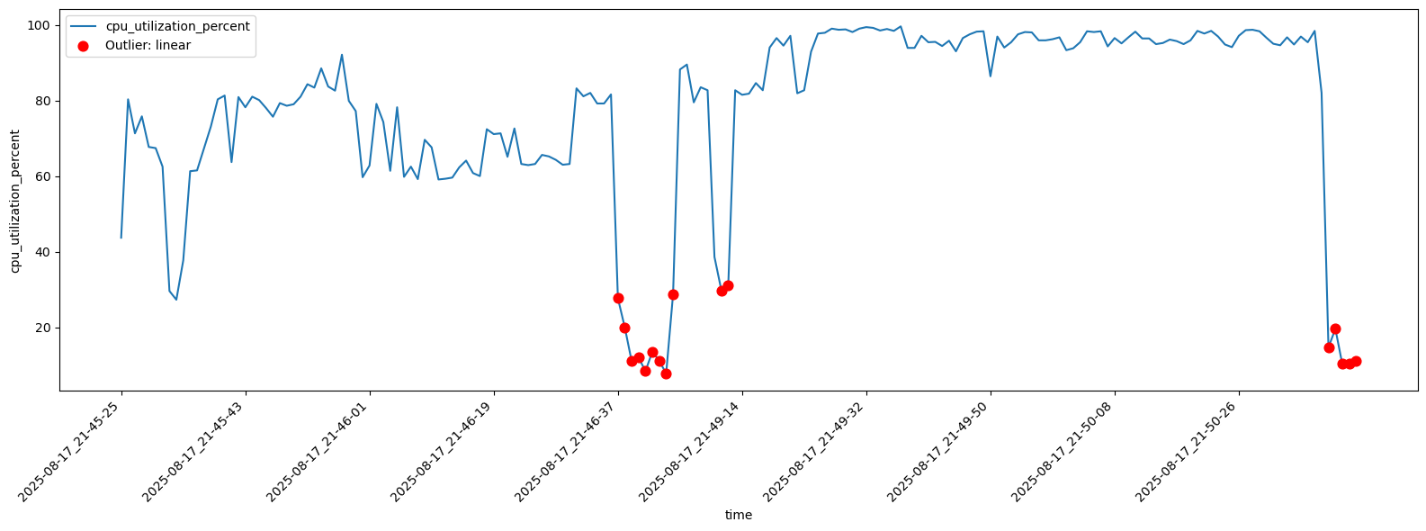

Handling Outliers Methods – Linear Regression
Threshold 2 (top plot): Flags only the strong outliers → less sensitive, fewer points.
Threshold 1.5 (bottom plot): Flags more points, including smaller deviations → more sensitive.
Overall:
  Lower threshold = more detection,
  higher threshold = fewer detections;
  choice depends on balance between catching more vs avoiding extra noise
These 2 plots show linear regression detection of outliers, first one on threshold of 2, and the second one on threshold of 1.5.

Slide 27
Handling Outliers Methods – LOF
Pros:
  Good at finding local outliers (not just global ones).
  Works well with complex data shapes.
  No strong assumption about data distribution.
Cons:
  Can be slow for large datasets.
  Needs parameter tuning (like neighbors).
  Results can change with small data changes.
Use when data is nonlinear, clustered, or locally complex.
→ Best for capturing unusual local behavior, but requires parameter tuning and can be slower.

Slide 28

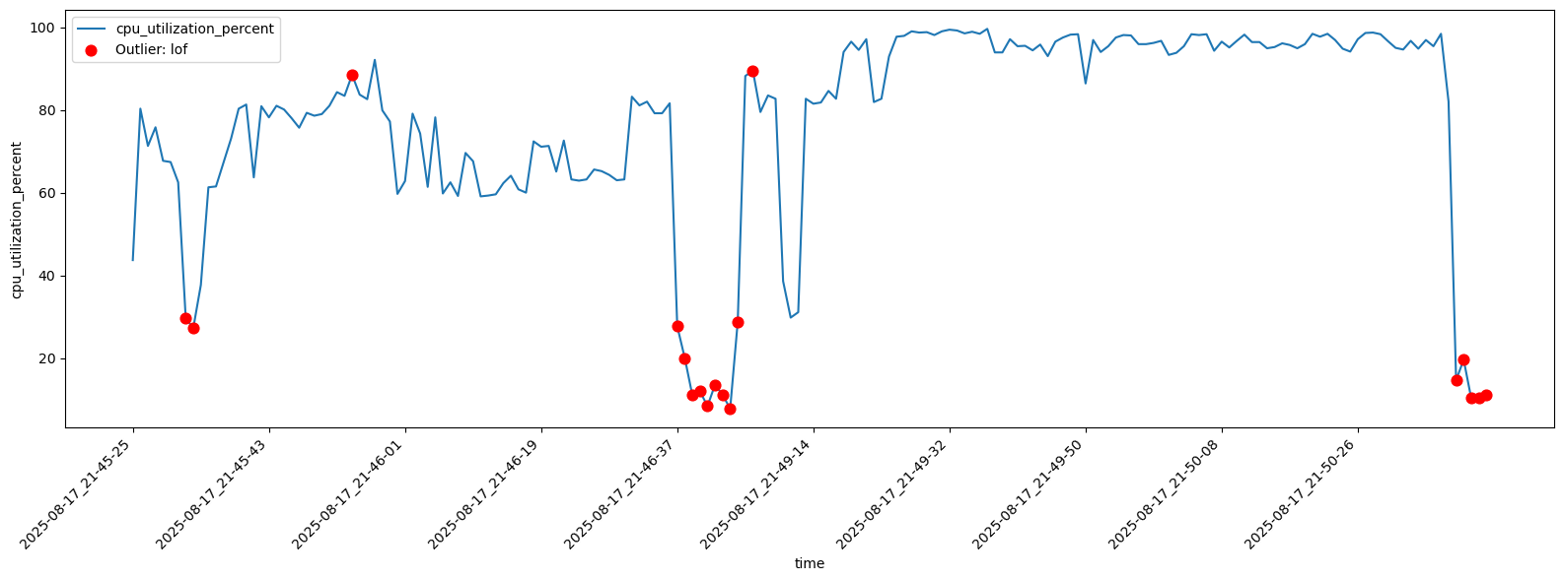
Handling Outliers Methods – LOF
90 neighbors (top): Outliers found only when clearly different from many nearby points → less sensitive.
50 neighbors (bottom): Picks more outliers, even smaller local changes → more sensitive.
Overall:
  Fewer neighbors = more sensitive detection,
  more neighbors = stricter detection.
These 2 plots shows the LOF outlier detection, first one on 90 neighbors, and the second one on 50 of neighbors, with a constant contamination= 0.1

Slide 29
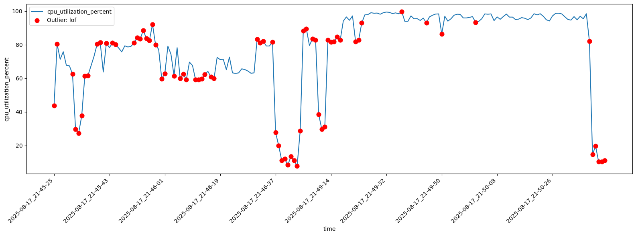
Handling Outliers Methods – LOF
Contamination = 0.1 (top): Flags fewer points, focuses on the most unusual ones → stricter detection.
Contamination = 0.4 (bottom): Flags many more points, including normal ones → more relaxed detection.
Overall:
  Higher contamination = more outliers detected (but risk of false alarms),
  lower contamination = fewer, stricter outliers.
These 2 plots shows the LOF outlier detection, first one on contamination= 0.1,
and the second one on contamination= 0.4, with a constant neighbors = 90.

Slide 30
Handling Outliers Methods – All
Z-Score: Easy, clear cutoff; good for normal data but may miss context
IQR: Robust to extremes; works on small data but can miss subtle changes
Linear Regression: Finds points far from trend; good for clear patterns, weaker for complex ones
LOF: Detects local outliers; flexible but sensitive to parameter choice

Slide 31
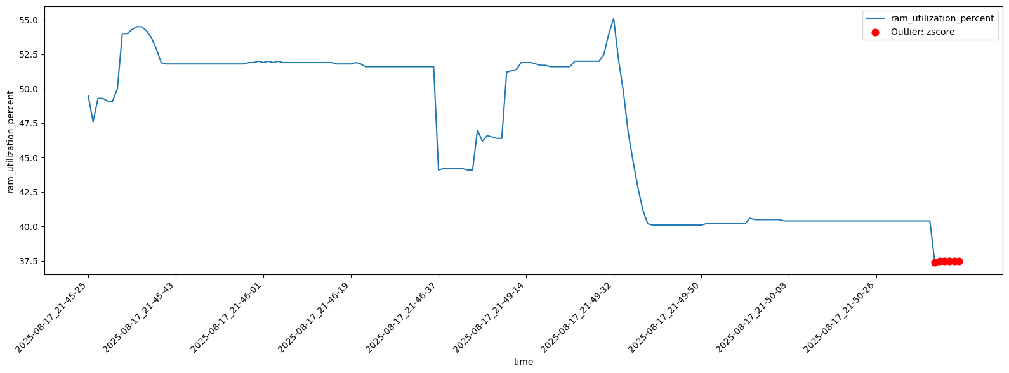
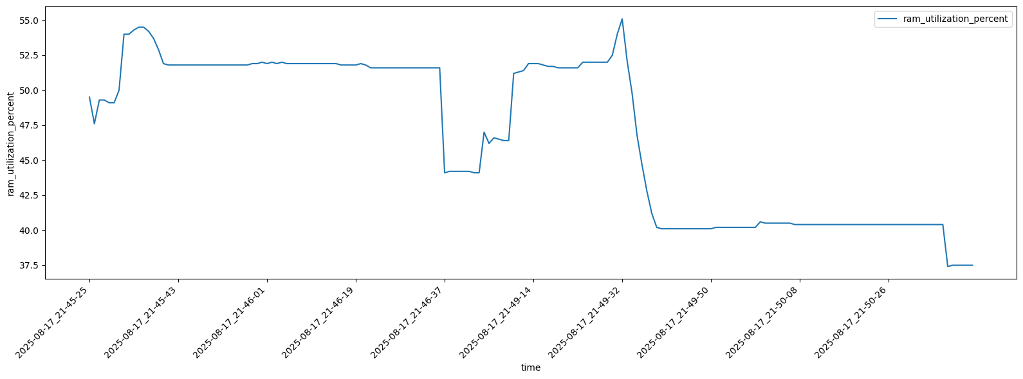
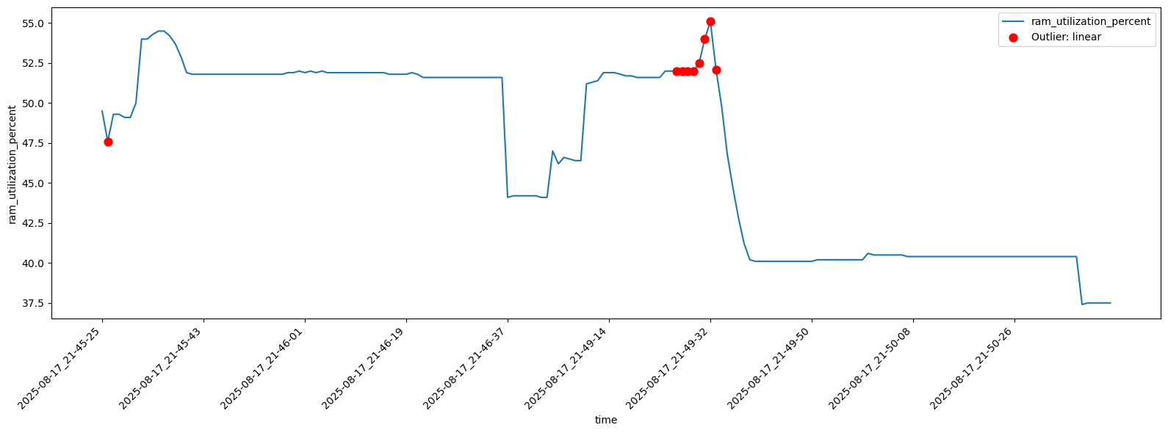
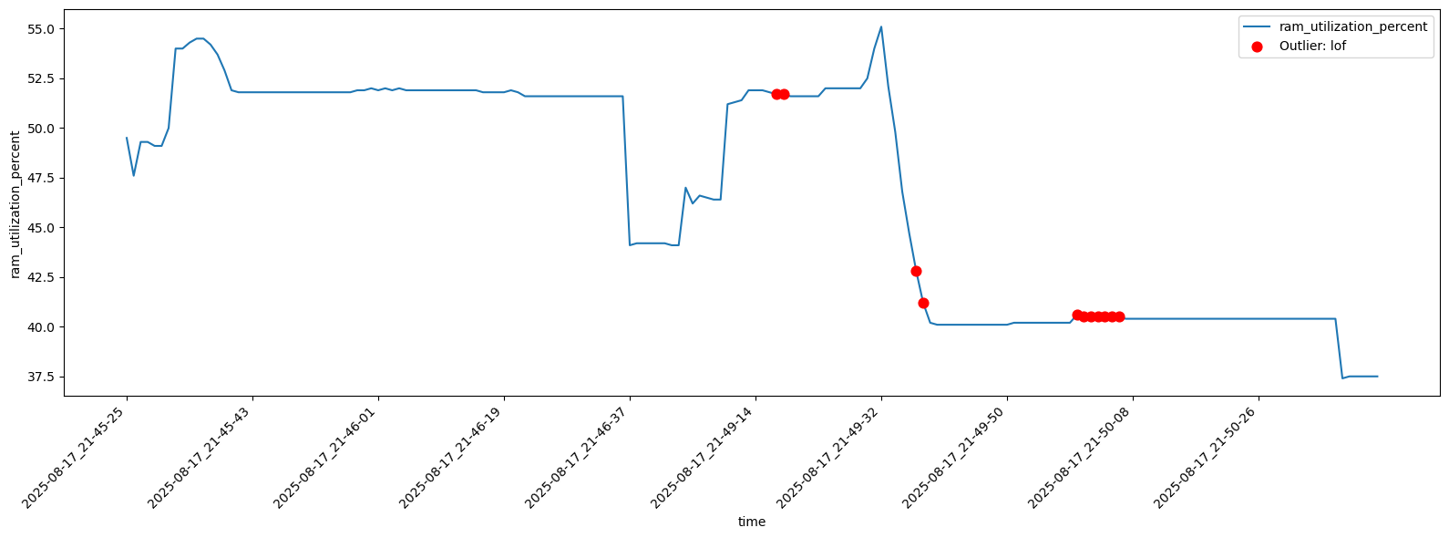
Handling Outliers Methods – False Alarms
Z-Score: Marks steady points at the end as outliers → high chance of false alarms in flat data
IQR: No false alarms here → more stable for this dataset
Linear Regression: Flags normal spikes as outliers → can misjudge small changes near trend
LOF: Detects several regular points as outliers → sensitive to parameter choice

Slide 32
Sensitivity
Using pre-defined sensitivities for removing outliers, to make it easier for the user to choose between them.
Used sensitivities:
  Low: The method detects only the almost extreme outliers, while moderate or local anomalies remain undetected.
  Medium: The methods detect both extreme and moderate outliers, capturing more spikes, dips, and unusual deviations, but still ignoring very subtle local anomalies.
  High: The methods detect nearly all deviations - including extreme, moderate, and even subtle fluctuations- leading to a large number of flagged points.

Slide 33
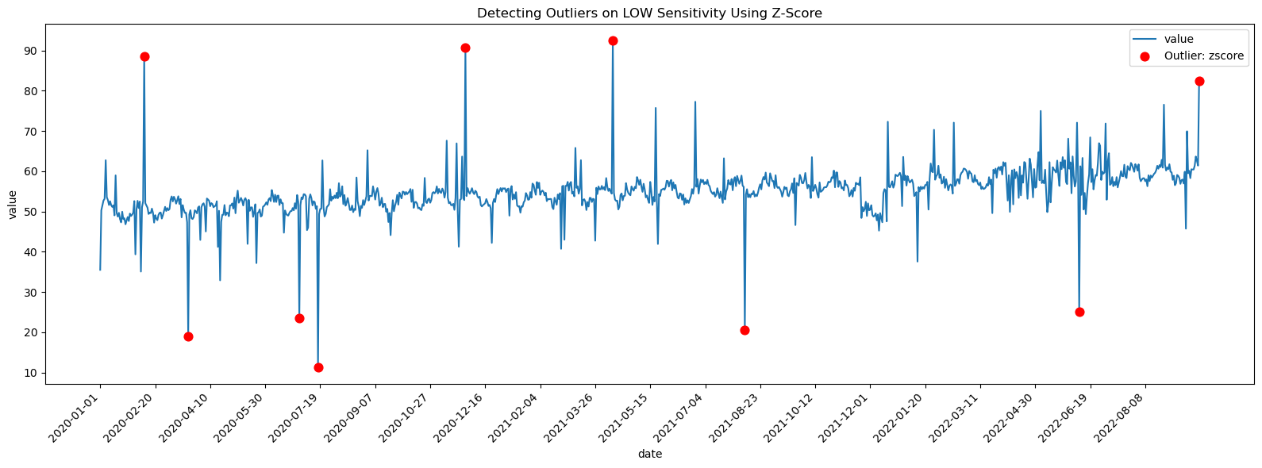
LOW Sensitivity – Z-Score

Slide 34
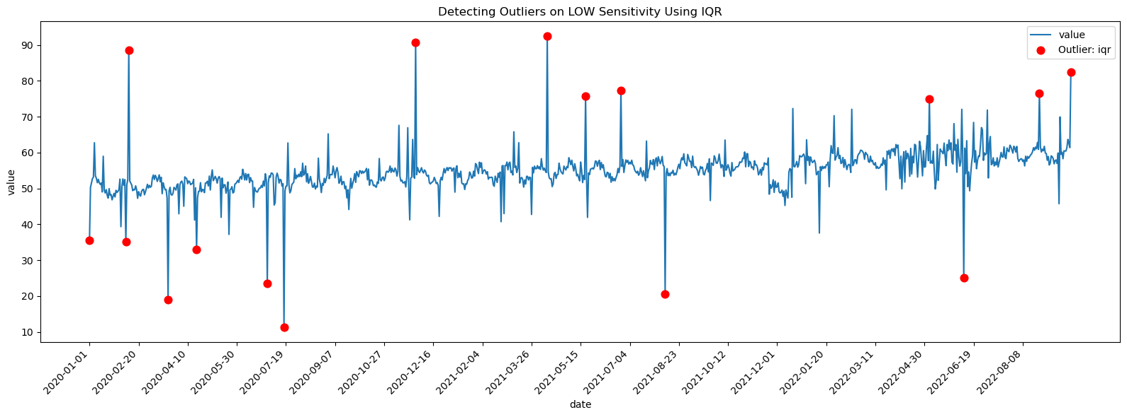
LOW Sensitivity - IQR

Slide 35
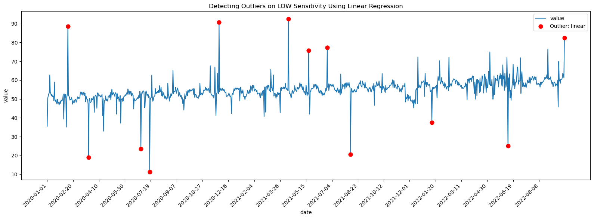
LOW Sensitivity – Linear Regression

Slide 36

LOW Sensitivity - LOF

Slide 37
LOW Sensitivity - ALL

Slide 38
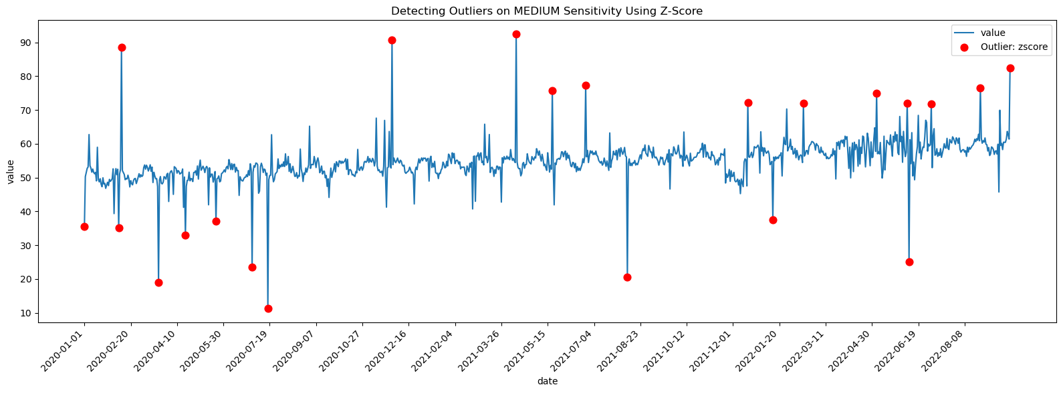
MEDIUM Sensitivity – Z-Score

Slide 39
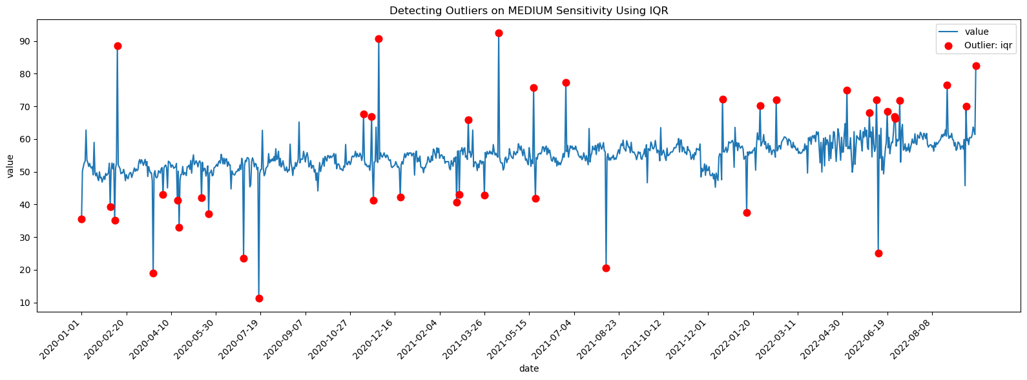
MEDIUM Sensitivity - IQR

Slide 40
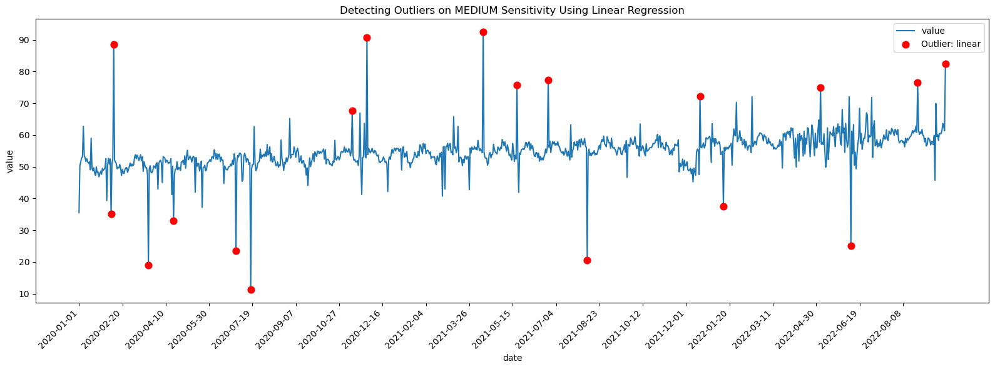
MEDIUM Sensitivity –Linear Regression

Slide 41
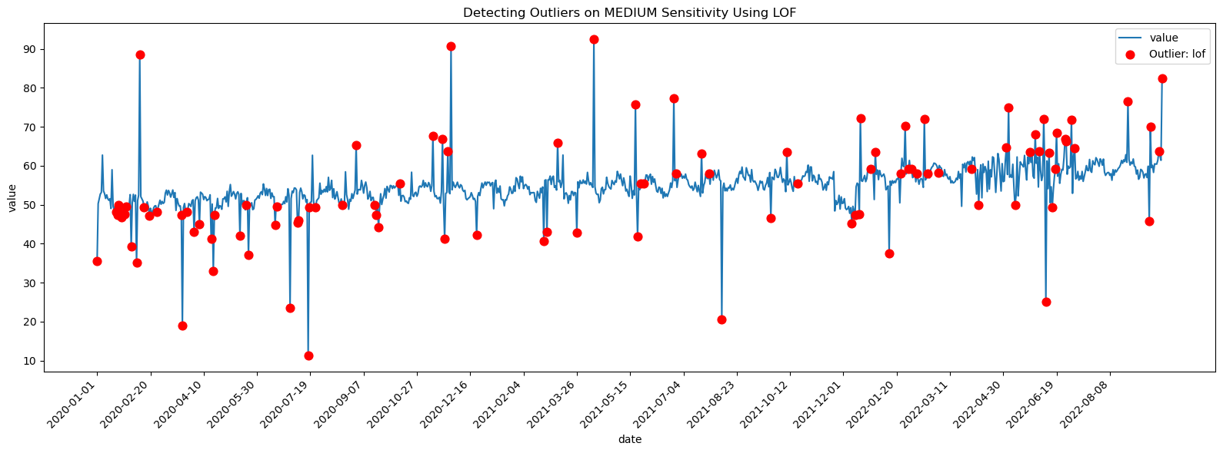
MEDIUM Sensitivity - LOF

Slide 42
MEDIUM Sensitivity - ALL

Slide 43
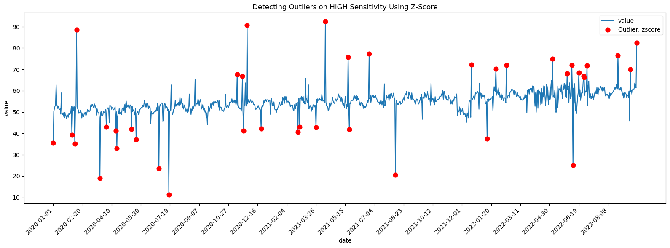
HIGH Sensitivity – Z-Score

Slide 44
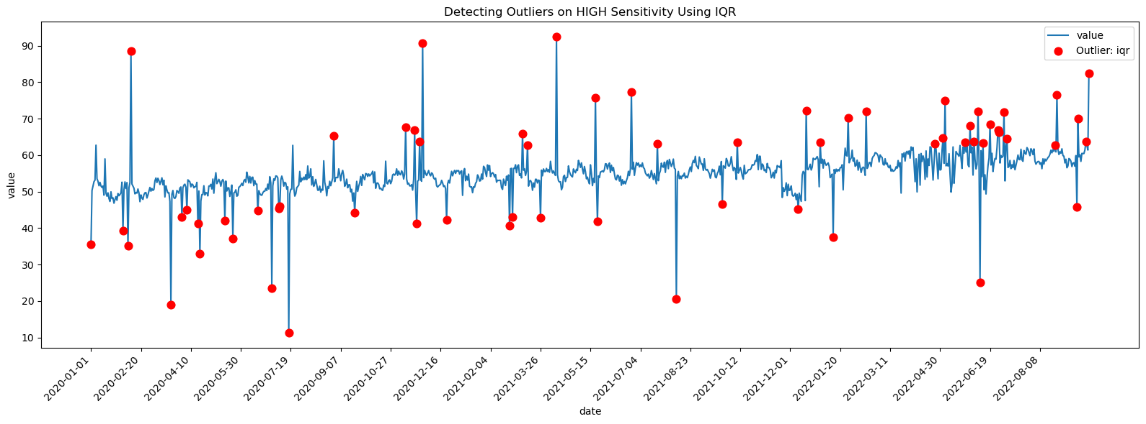
HIGH Sensitivity - IQR

Slide 45
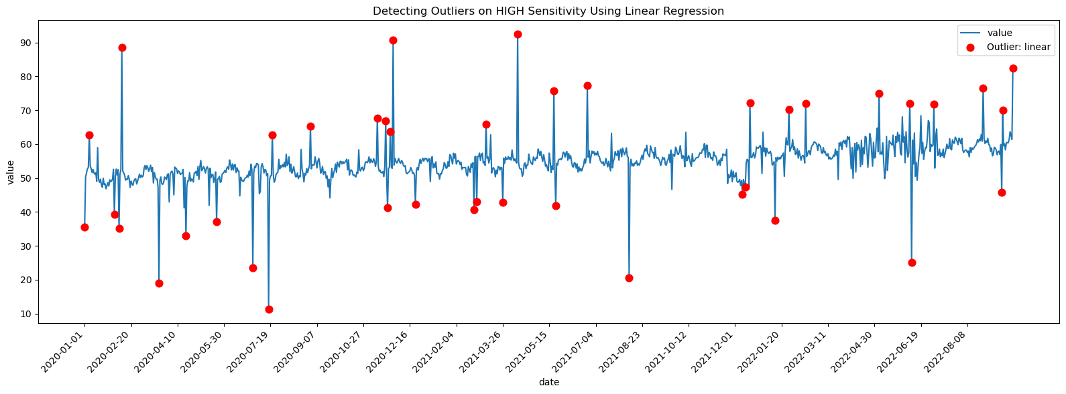
HIGH Sensitivity – Linear Regression

Slide 46
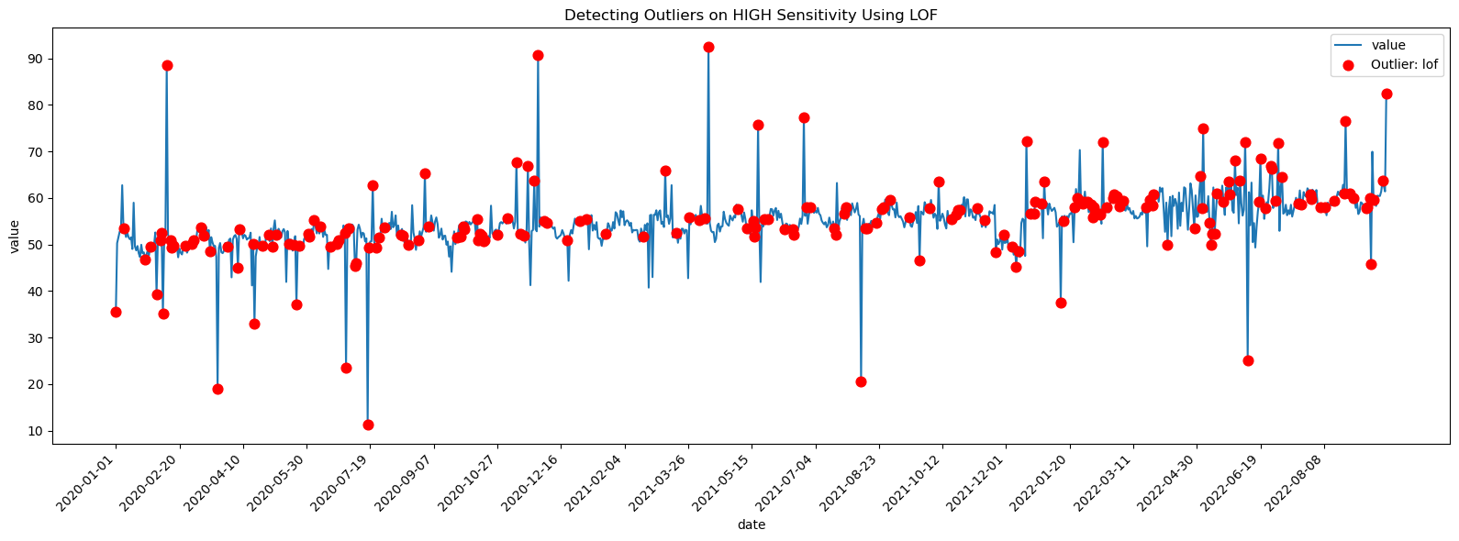
HIGH Sensitivity - LOF

Slide 47
HIGH Sensitivity - ALL

Slide 48
Handling Outliers Methods – Conclusion
No single method is best — each has strengths and limits.
Z-Score & IQR: Simple, good for basic detection but may miss context.
Linear Regression: Works when trend matters, weaker for sudden changes.
LOF: Best for complex/local patterns, but needs tuning.
Choice depends on data type, size, and goal (catch more vs reduce false alarms)
Outlier detection is context-dependent
pick the method that balances sensitivity and false alarms for your data.

Slide 49
Rolling Windows

Slide 50
What is Rolling Window
Rolling windows = moving subsets of data over time.
Apply functions like mean, std, sum, median to detect local behavior.
Useful for smoothing, detecting volatility, trends, seasonality, and anomalies.

Slide 51
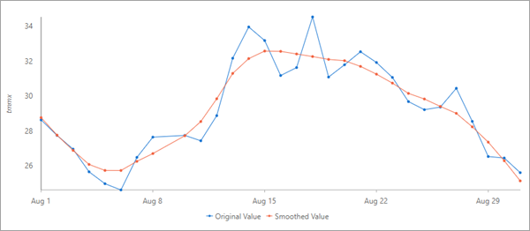
Smoothing / Noise Reduction
How it works:
  Replace each value with the average of its surrounding values.
  Reduces short-term fluctuations and highlights long-term patterns.
Methods:
  Mean → simple moving average
  Median → robust to outliers
Example:
  Daily temperature data → 7-day rolling mean smooths random day-to-day changes.
  Stock prices → moving average line to reduce noise.

Slide 52
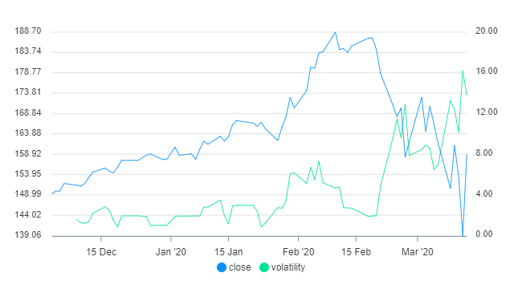
Volatility Estimation
How it works:
  Use rolling standard deviation or variance to measure recent variability.
  Larger values = higher uncertainty.
Methods:
  Standard Deviation (std) → most common
  Variance (var) → similar, squared scale
Example:
  Finance: 30-day rolling standard deviation of stock returns shows short-term risk.
  Energy: rolling std of electricity demand reveals unstable usage periods.

Slide 53
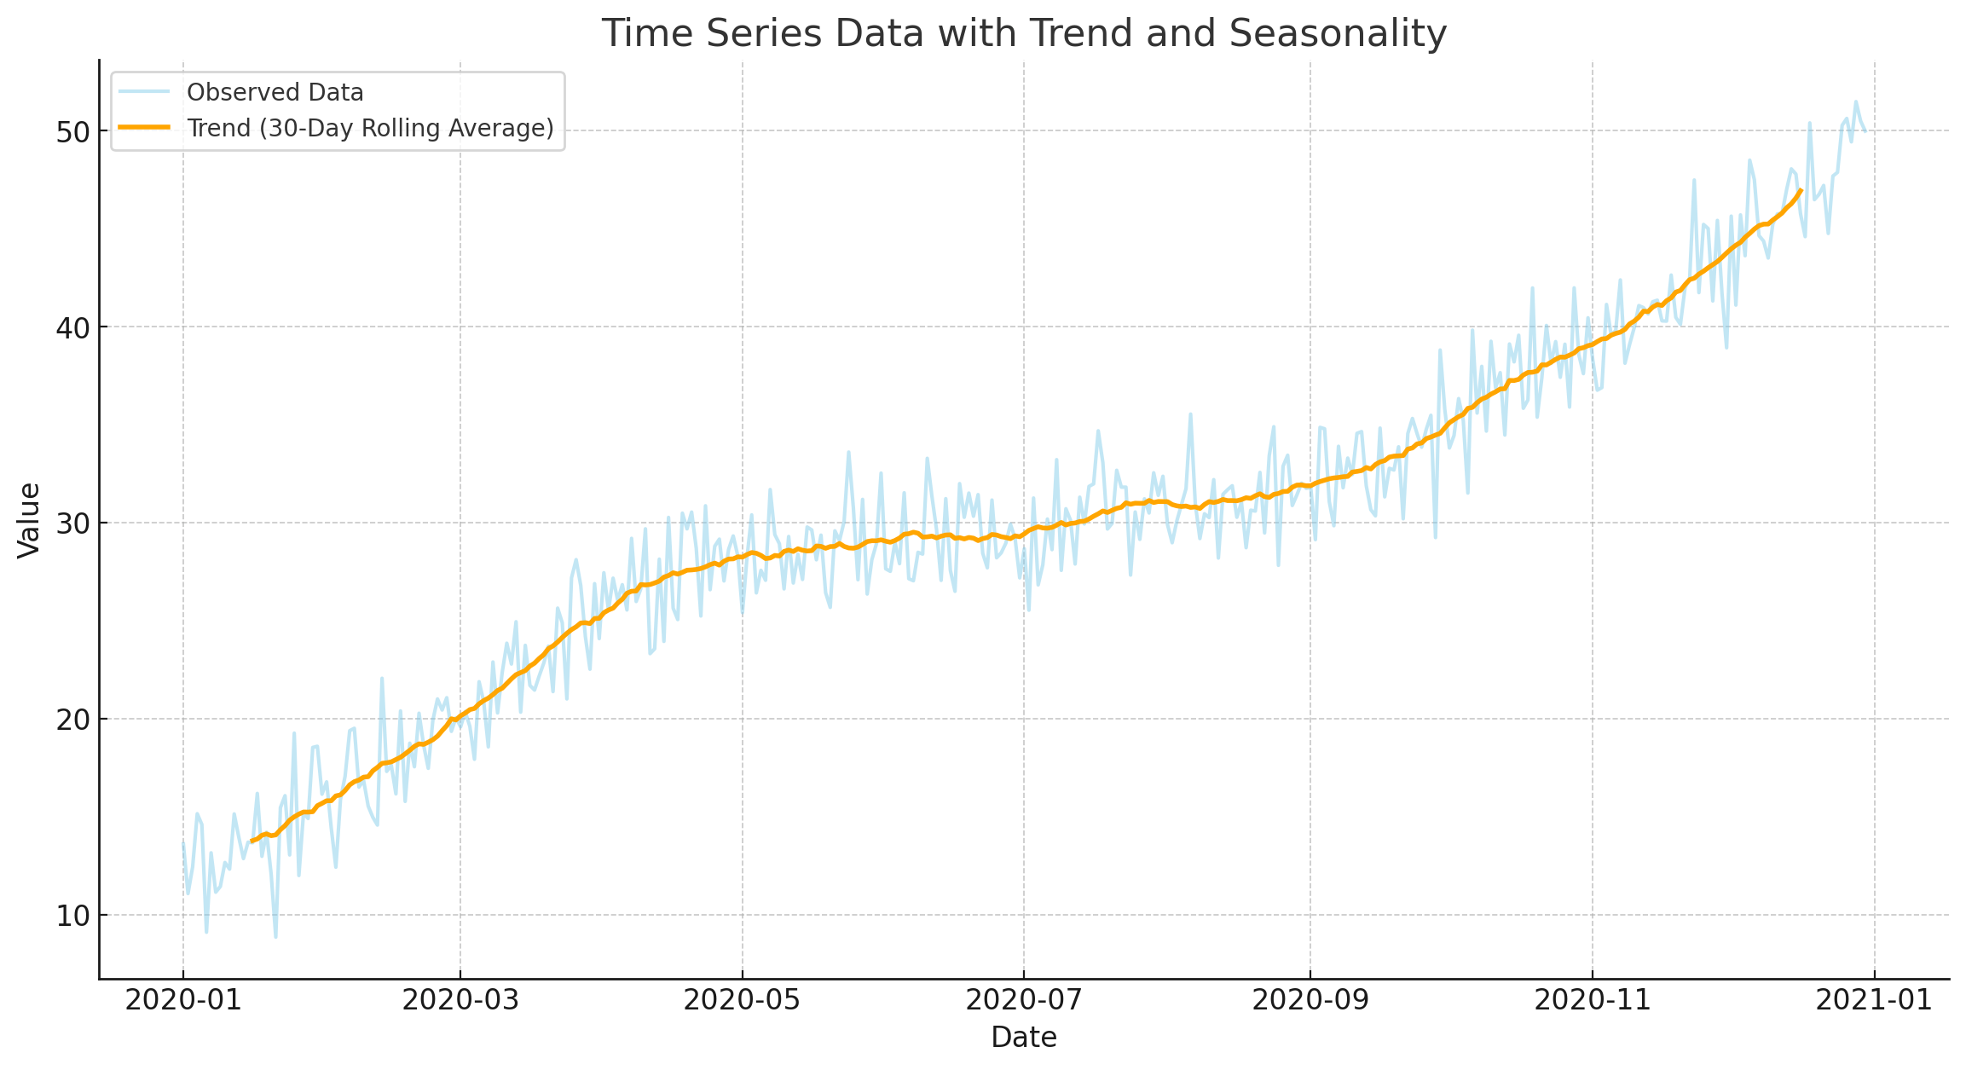
Trend Detection
How it works:
  Rolling mean highlights the underlying direction of the series.
  Compare current values with rolling average.
  Combine short and long rolling windows for trend signals.
Methods:
  Mean → classic trend indicator (rolling average)
  Sum → cumulative trend (e.g., total sales over window)
  Median / Quantile → robust trend line (resistant to outliers)
Example:
  Sales: 30-day rolling mean vs. daily sales → growth or decline trend.
  Stocks: 50-day vs. 200-day moving averages (technical analysis).

Slide 54
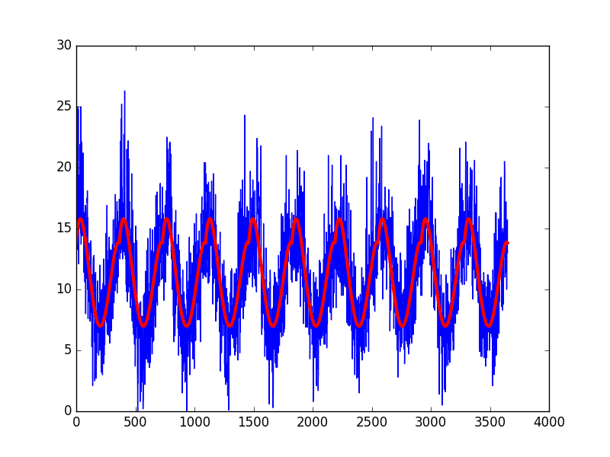
Seasonality Detection
How it works:
  Apply rolling mean with a season-length window.
  Reveals repeating cycles (weekly, yearly, etc.).
Methods:
  Mean → smooths across seasonal cycle.
  Sum → captures additive seasonality (e.g., total sales per cycle).
  Median → handles seasonal spikes/outliers.
Example:
  Energy: 365-day rolling mean of daily demand shows yearly cycles.
  Retail: 7-day rolling mean highlights weekly shopping behavior.

Slide 55
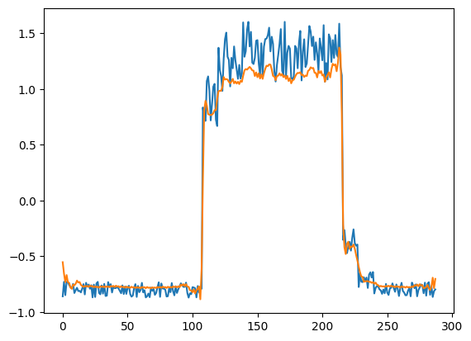
Anomaly Detection
How it works:
  Compare current value with rolling mean ± k * rolling std.
  Outliers are points far outside the expected range.
Methods:
  Mean + Std → z-score style detection.
  Median + Quantile → robust anomaly detection (less sensitive to skew/outliers).
  Min / Max → simple rolling bounds for extremes.
Example:
  Website traffic: sudden spikes beyond 3 * std = possible attack or viral event.
  IoT sensors: abnormal readings detected using rolling window thresholds.

Slide 56
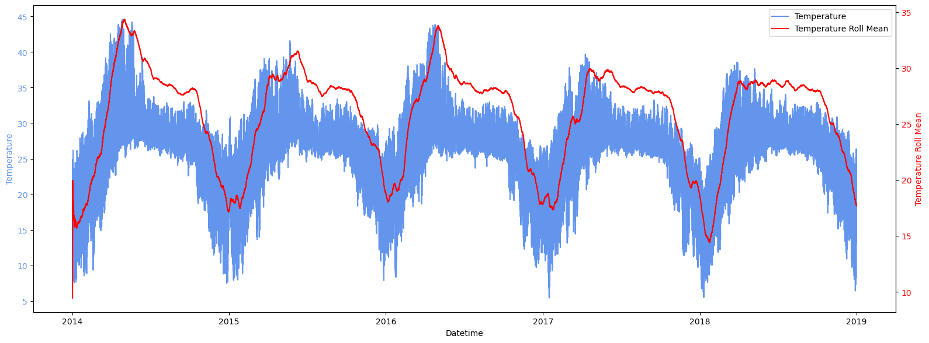
Rolling Mean

Slide 57
Rolling Mean
Description:
  The graph shows the actual temperature values (blue) alongside a rolling mean (red) over time.
Insights:
  Clear seasonal patterns: peaks in summer and troughs in winter each year.
  The rolling mean smooths out daily fluctuations, highlighting long-term trends.
  Over the years, the peak summer temperatures and trough winter temperatures are consistent, showing stability in seasonal cycles.
Key Point:
  The rolling mean allows us to observe general seasonal trends without being distracted by daily noise.

Slide 58
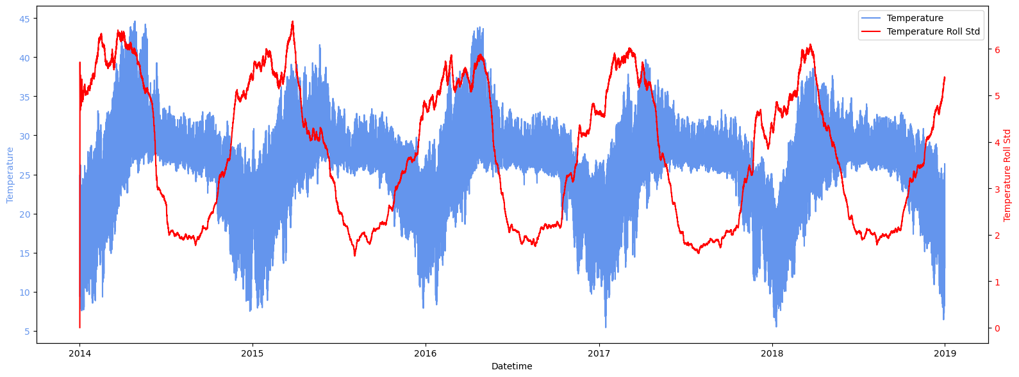
Rolling Standard Deviation

Slide 59
Rolling Standard Deviation
Description:
  The second graph shows the actual temperature values (blue) with the rolling standard deviation (red) over time.
Insights:
  The rolling standard deviation indicates variability in temperature.
  Variability is higher during seasonal transitions (spring/autumn) compared to summer/winter.
  Periods of high standard deviation correspond to unstable weather conditions (e.g., fluctuating between warm and cool days).
Key Point:
  The rolling standard deviation highlights periods of greater weather instability across the years.

Slide 60
Rolling Mean vs. STD
The rolling mean highlights long-term seasonal cycles.
The rolling standard deviation highlights short-term variability within those cycles.
Together, they provide a deeper understanding of both trends and fluctuations in temperature over time.

Slide 61
Conclusion
Rolling windows provide local insights from noisy time series.
Core applications:
  Smoothing
  Volatility estimation
  Trend detection
  Seasonality detection
  Anomaly detection
Foundation for both exploratory analysis and predictive modeling.

Slide 62
Time Series Module

Slide 63
What is a Module?
Definition:
  A module is a Python file containing functions, classes, or variables.
  It allows you to logically organize code into separate files.
Why it’s used:
  Promotes code reuse and avoids duplication.
  Improves readability and maintainability.
  Makes collaboration easier in larger projects.
Use cases:
  math module → mathematical functions (sqrt, pi, etc.).
  datetime module → handling dates and times.
  os module → interacting with the operating system.

Slide 64
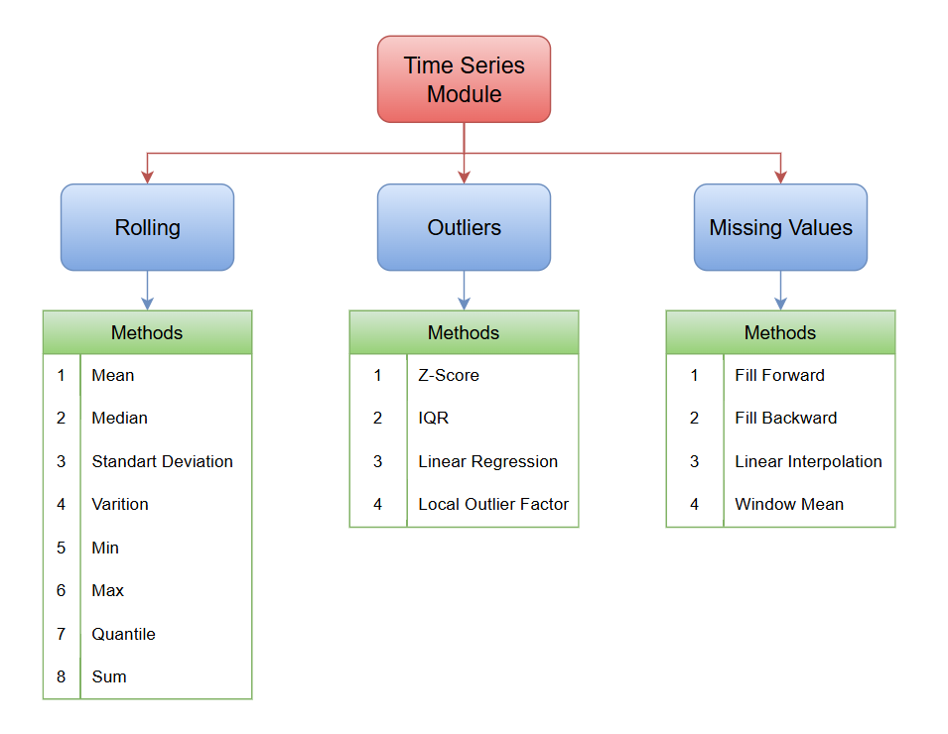
Time Series Module Structure

Slide 65
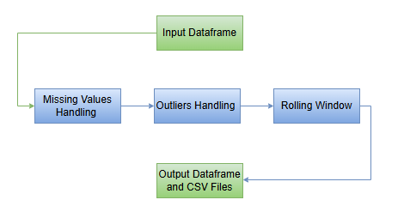
Time Series Module Pipeline

Slide 66

Time Series Module Architecture
Script to log memory / CPU metrics.
Handling Outliers
Smoothing Data by Rolling Average
Storing data
Reading data
Time Series Module
Push results

